Slide 1
Chapter 9
Transaction Management and Concurrency Control

Slide 2
In this chapter, you will learn:
What a database transaction is and what its properties are
How database transactions are managed
What concurrency control is and what role it plays in maintaining the database’s integrity
What locking methods are and how they work
How database recovery management is used to maintain database integrity

Slide 3
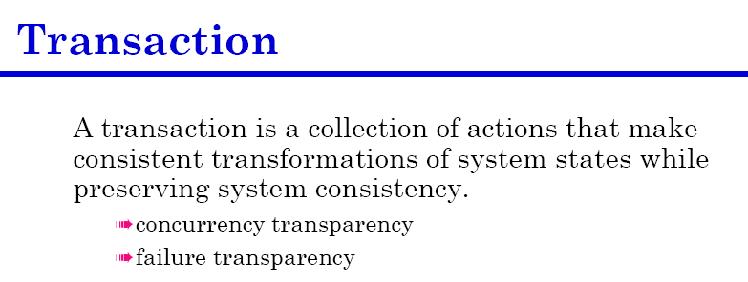
What is a Transaction?
Read from or write to a database, create a transaction.
It can be a single SQL command or series of related commands
In practical, transactions are formed by two or more database requests
Database request is the equivalent of a single SQL statement
Notes:
4

Slide 4
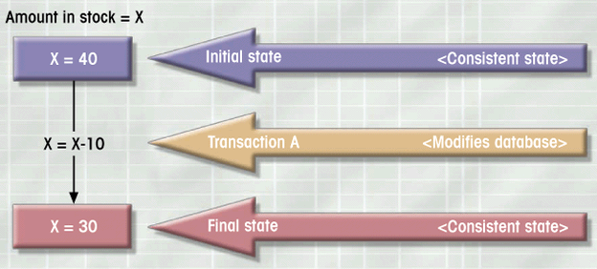
What is a Transaction?
Logical unit of work
Must be either entirely completed or aborted
No intermediate states are acceptable
Figure 9.1
Notes:
4

Slide 5
What is a Transaction?
Transaction changes the contents of the database must alter the database from one consistent state to another.
Consistent database state is one in which all data integrity constraints are satisfied.
All transactions are controlled and executed by the DBMS to guarantee database integrity.
Notes:
4

Slide 6
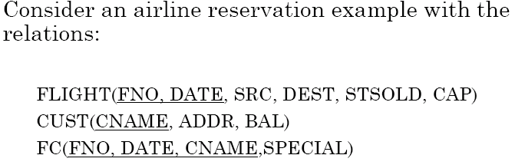
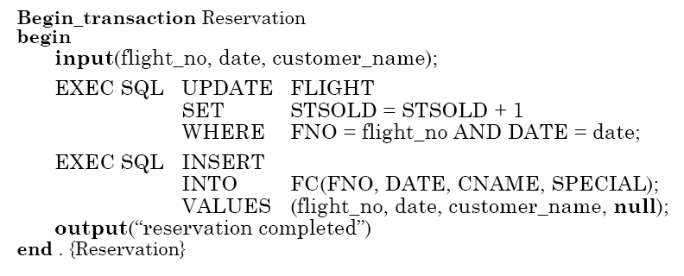
Transaction Example
Notes:
4

Slide 7
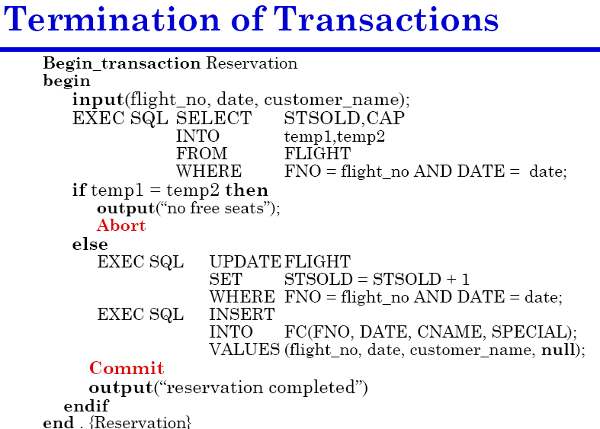

Slide 8
Example Transaction
Register credit sale of 100 units of product X to customer Y for $500
  Reduce product X’s quantity by 100
  Adding $500 to customer Y’s account receivable
UPDATE PRODUCT
SET PROD_QOH = PROD_QOH - 100
WHERE PROD_CODE = ‘X’;
UPDATE ACCT_RECEIVABLE
SET ACCT_BALANCE = ACCT_BALANCE + 500
WHERE ACCT_NUM = ‘Y’;
Notes:
6

Slide 9
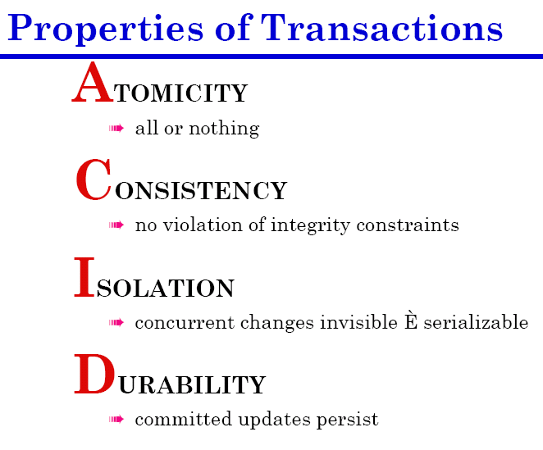

Slide 11
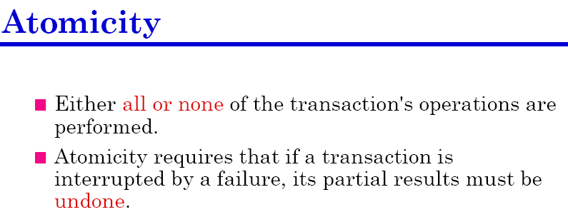
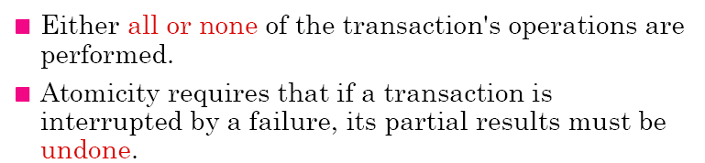

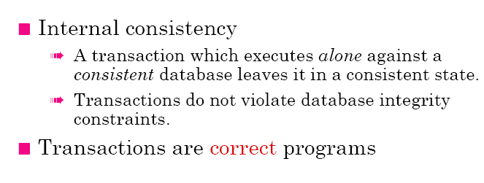
Transaction Properties
Notes:
6

Slide 12
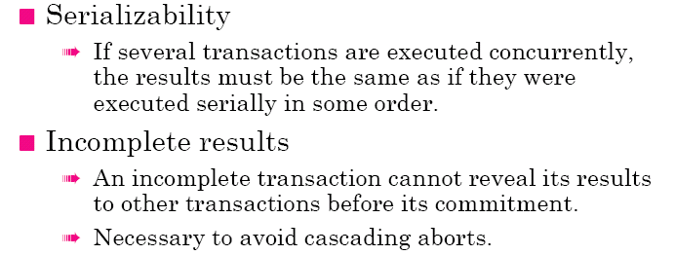
Transaction Properties

Slide 13
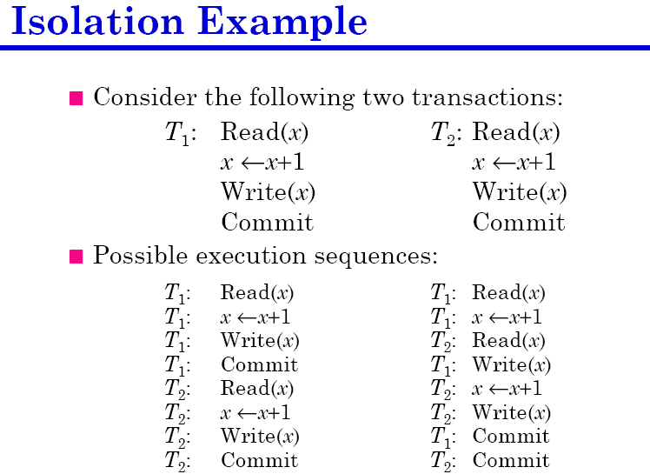

Slide 14
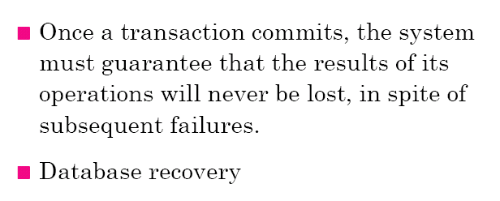
Transaction Properties
Notes:
9

Slide 15
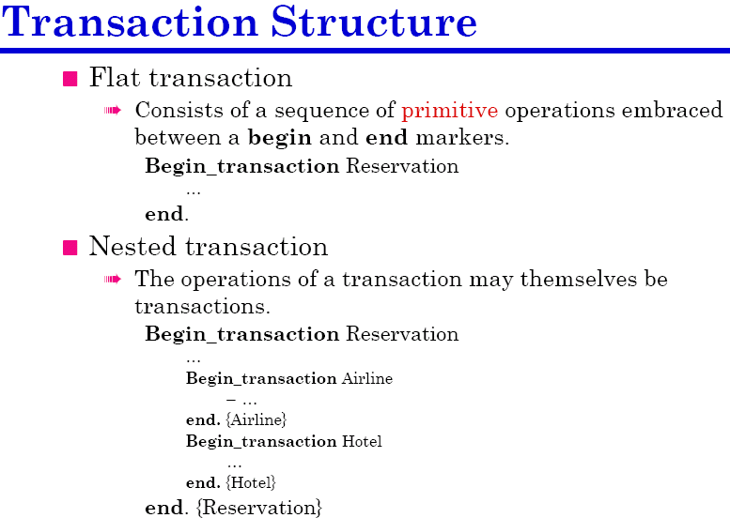
Notes:
10

Slide 16
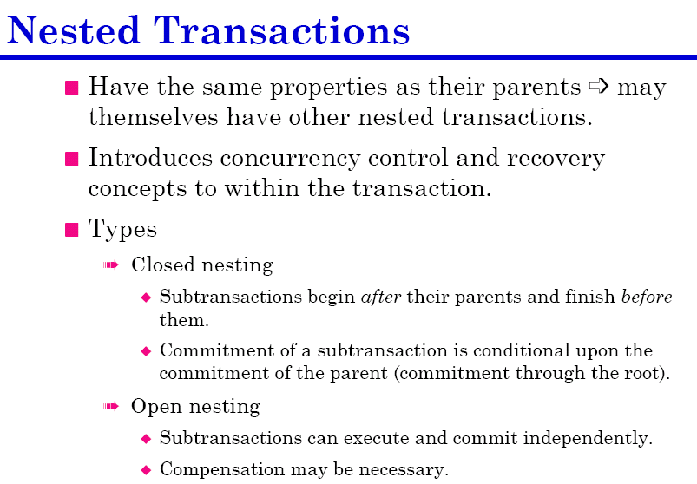

Slide 17

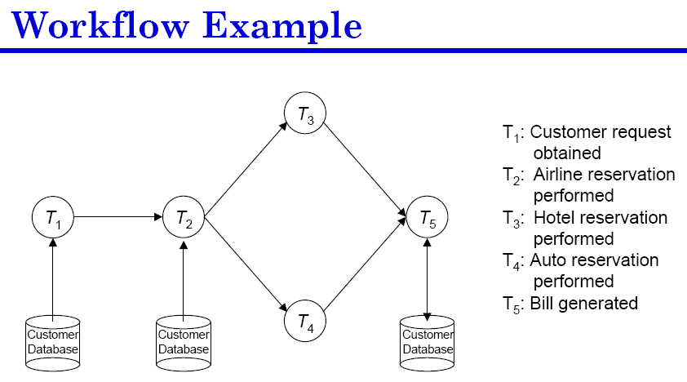

Slide 18
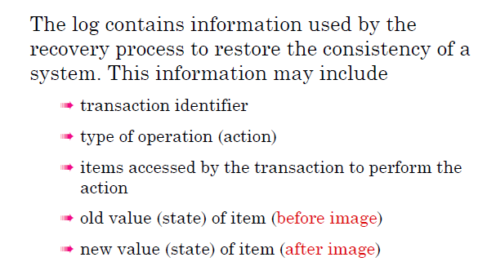
Logging

Slide 19
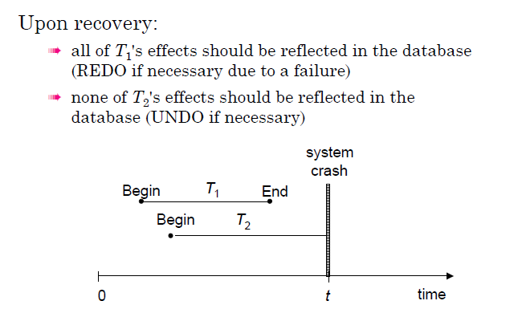
Logging (redo-undo)

Slide 20
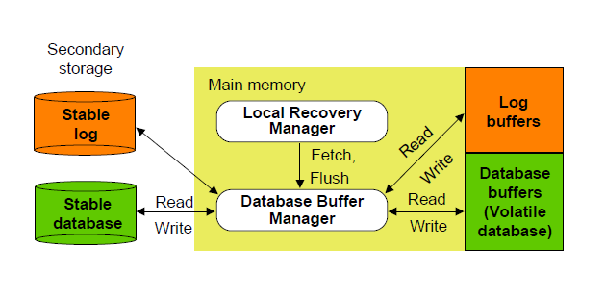
Architecture
Fix, Flush, Checkpoint

Slide 21
